Slide 1
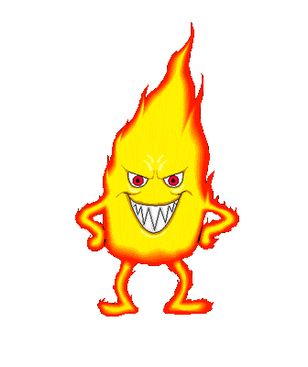
Fire Safety Awareness For Kids
Team Members: Anita Devi Avikash Nand

Slide 2
Introduction
Every day, at least one child dies from a home fire and another 293 children are injured from fires or burns. Ninety percent of all fire-related deaths are due to home fires. Home fires can spread rapidly and leave families as little as two minutes to escape after an alarm sounds(Safe Kids, 2013)
Nobody knows when a fire would start. It is something unexpected but it happens and so many lives are lost. This has motivated us to do a project on Fire Safety.
In schools, kindergarten and child care centers care and safety is important for the young ones . During the event of fire at these places, we have seen a lot of children get hurt and some even get seriously injured in the process of saving themselves. This can be avoided by through practice of fire safety drills every now and then.

Slide 3


Problem
Kids these days aren’t being taught about fire safety in some schools today.
Lack of time & Resources
Kids end up getting badly injured

Slide 4
Research Question + Scope
Research Question : Can we maximise fire safety awareness among kids through a mobile game? Scope: This project involves proposing and creating mobile game to bring awareness among kids. This game will be targeting kids aged 10 years & Under.

Slide 5
Aims & Objectives
Aim : To investigate whether a mobile game on fire safety will be able to maximise fire safety awareness among kids at Primary schools, Kindergartens and Child care centres. Objectives: 1.Designing of an interactive & Addictive game
2. Research similar related games on Fire Safety and find out about their Pros & Cons
3.Implementing of the design on a mobile platform using Android Studio

Slide 6
MOV Statement
The implementation of the mobile game will have a greater social impact on kids.
It will also have an impact on teachers & parents whereby they will be saving time in educating children on Fire Safety.

Slide 7

Literature Review
The Literature review analyses other fire safety android games developed for mobile development. The functionalities of current fire safety apps are also briefly explained, and their strengths and weaknesses identified.

Slide 8
Comparing Fire Safety Related Apps
Fire Safety for Kids
Series of Quizzes with 3 different Levels
4 star Rating Developed by Kenobi group
Lift Safety for Kids
5 different levels teaching you about Lift Safety If right answer chosen proceed to next round. Wrong then choose again 4.1 Rating
Developed by GameiCreate company
Help Mikey
How to get out of house when fire arises
Select right answer to proceed to next round.
4.7 rating developed by Animatus Studio

Slide 9
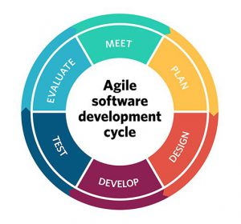
Software Methodology
The software methodology that we will use for our project is Agile methodology.
Agile methodology minimizes risks by developing the software in small parts called iterations. Iteration includes all the tasks necessary to release the mini-increment of new functionality: planning, requirements analysis, design, coding, testing, and documentation. At the end of each iteration, the team re-evaluates project priorities.

Slide 10

Structure Of Our Game
What would you do if your clothes catch on fire?
DO YOU
1. Run or 2. Stop, Drop & Roll
If right answer selected then move on to next round for more set of questions
If wrong, Message box will appear briefly explaining why it is wrong.

Slide 11
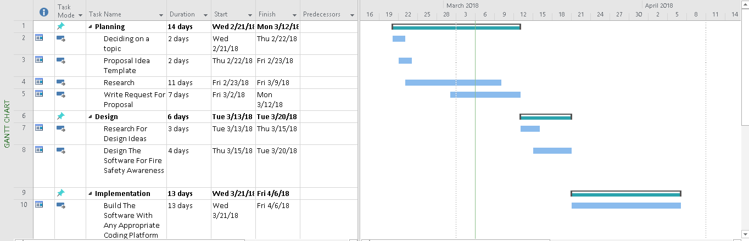
Gantt Chart

Slide 12
Slogans
Accident brings tears, fire safety brings cheers.
Fire Safety on , accidents gone.
Fire is a good servant but a bad master.
Fire loss is a national loss
From <https://brandongaille.com/list-50-great-fire-safety-campaign-slogans/>

